Slide 1
Impact of environmental triggers and seasonality on the epithelium
Marco Caminati
Department of Medicine
Allergy, Asthma and Clinical Immunology Section
University of Verona, Italy

Slide 2
Conflicts of interest disclosure
Consultancy fees:
AstraZeneca
GlaxoSmithKline
Speaker fees:
AstraZeneca
GlaxoSmithKline
Sanofi
Educational programmes:
GlaxoSmithKline

Slide 3
Asthma and environmental determinants – clinical observations
Trends and determinants of ER admissions for asthma: a retrospective evaluation in Northeast Italy
Trend of admissions in Northeast Italy during the whole year, paired with grass pollen count
250
ER admission
Grass pollen
50
Average daily ER admissions by PM₁₀ and O₃ levels
Pollutants (µg/m³) | Days | Daily ER admissions (mean) | P-value
O₃ ≤120 | 2129 | 0.8027 | 0.9368
O₃ >120 | 63 | 0.7937
PM₁₀ ≤50 | 1678 | 0.7729 | 0.0053
PM₁₀ >50 | 514 | 0.8988
45
200
*
40
*
35
150
30
Number of ER admissions
Pollen count (gr/m³)
25
100
20
15
50
10
5
0
0
Jan
Feb
Mar
Apr
May
Jun
Jul
Aug
Sep
Oct
Nov
Dec
Months
*P-value <0.05
ER, emergency room; O₃, ozone; PM₁₀, particulate matter
Caminati M, et al. World Allergy Organ J 2019;12:100046

Slide 4
Asthma and environmental determinants – clinical observations
Levels of pollutants (NO, PM₁₀ and O₃) registered at the place and at the time of the deaths.
Patients’ initials are reported on the x-axis (n=17). In 3 days, the concentration of ozone was above the accepted limits (120 μg/m³), whereas in only 1 day, the level of PM₁₀ was significantly
over the permitted values (50 μg/m³ )
Aerobiological data at the time and places of the deaths. Patients’ initials are reported on the
x-axis (n=17). The pollen count was low for all pollens detected (grass, birch, parietaria and ragweed), whereas in 6 days, a high concentration of alternaria was registered
180
NO concentration
Mean PM₁₀
Mean O₃ concentration
500
Grass
Parietaria
Birch
Alternaria
Ragweed
160
450
140
400
120
350
300
100
µg/m³
250
Pollen/m³
80
200
60
150
40
100
20
50
0
0
GP
JV
LM
SM
RB
ST
AR
SH
MP
AV
KS
EA
KK
RT
MA
OZ
AB
GP
JV
LM
SM
RB
ST
AR
SH
MP
AV
KS
EA
KK
RT
MA
OZ
AB
Patient initials
Patient initials
NO, nitric oxide; O₃, ozone; PM₁₀, particulate matter
Vianello A, et al. World Allergy Organ J 2016;9:42

Slide 5
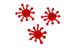


Asthma and environmental determinants – patients’ perspectives
Self-reported asthma triggers by proportion of patients
experiencing trigger and frequency of trigger*
Frequency of triggers
(weeks/year)
Allergic trigger
Non-allergic trigger
Frequency of trigger
A higher number of known asthma triggers correlates with an increased number of severe exacerbations
52% of participants self-reported exposure to 6–15 asthma triggers†
One in five patients do not attempt to avoid known asthma triggers until symptoms worsen
A medium to high asthma trigger burden (≥11 triggers) is associated with an adverse impact on daily life
Proportion of patients who experienced the trigger (%)
Self-reported asthma triggers (N=1202)
Top 15 triggers by proportion of patients experiencing given trigger
*Figure adapted from Price D, et al. J Asthma 2014;51:127–135 (http://creativecommons.org/licenses/by/3.0); †13% of patients reported 1–5 asthma triggers, and 35% reported ≥16
Price D, et al. J Asthma 2014;51:127–135
Notes:
Price: Table 2
Price: Pp129, col 2, para 8, lines 1-6 [bullet 1] pp129, col 2, para 2, lines 1-4 [bullet 2];
Pp 129, col 2, para 6, lines 3-6 [bullet 3];
Pp 131, col2, para 1, lines 1-4 [bullet 4]
Price: abstract, results, line 1
Price: pp127-8, col 2, para 3, lines 1-3; pp128, col 1, para 2, lines 1-4
Price: pp129, col 2, para 2, lines 4-8
Price: table 2

Slide 6
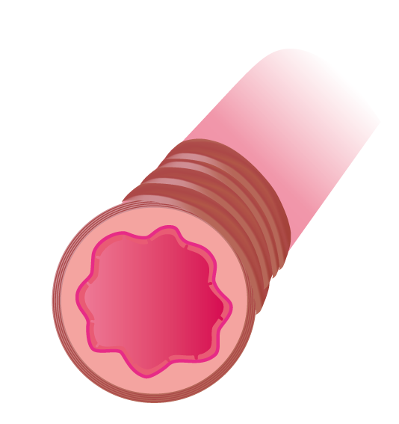

Asthma exacerbations – characterised by inflammation, bronchospasm and mucus hypersecretion
Allergens, viruses, bacteria, pollutants, smoke
Symptoms and inflammation
Time
Pathology^{1–3}
The image shows a massive infiltration and airways obstruction in the bronchus of a patient who died during the summer. Red arrow: bronchial lumen occluded by amorphous eosinophilic material corresponding to mucus plugs, mixed with inflammatory cells and epithelial cells. Green arrow: peribronchial and submucosal hyperaemia, thickening of the basal membrane with muscle hypertrophy. Blue arrow: neutrophilic and limphomonocitary inflammation. The patient was sensitised to alternaria, which was detected in the airways⁴
Inflammation
Bronchospasm
Mucus hypersecretion
Symptoms^{1–3}
Dyspnoea, cough, phlegm, drop in lung function
1. Fahy JV. Nat Rev Immunol 2015;15:57–65; 2. Gauvreau GM, et al. Expert Opin Ther Targets 2020;24:777–792; 3. Ishmael FT. J Am Osteopath Assoc 2011;111(Suppl. 7):S11–S17; 4. Vianello A, et al. World Allergy Organ J 2016;9:42

Slide 7
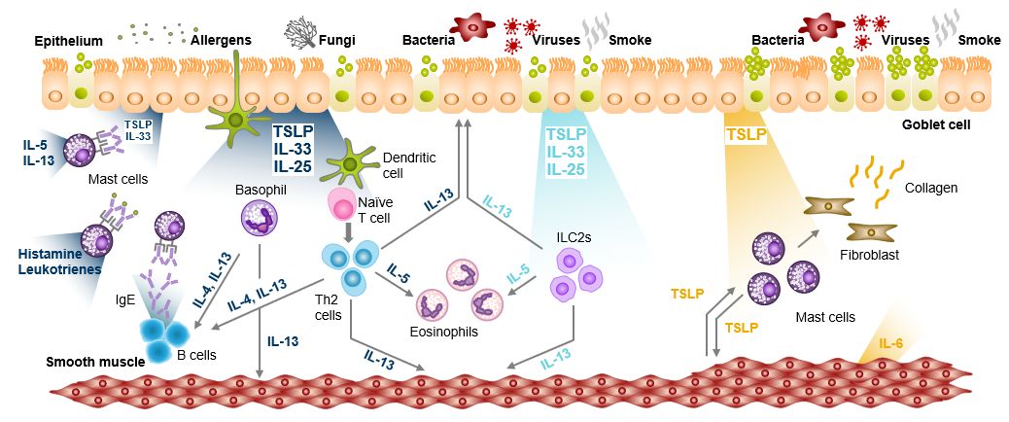
Asthma exacerbations and environment – is it only a matter of allergic inflammation?
Patients with asthma do experience asthma exacerbations when exposed to:¹
  Pollutants
  Pathogens
Environmental variables do represent asthma exacerbation triggers for non-allergic and
non-sensitised patients with asthma too¹
Some known allergens (ie house dust mites and mould) exert a ‘cytotoxic effect’ besides triggering IgE-mediated cascade, also in individuals with
non-atopic asthma^{1,2}
They are not allergens
Mechanisms underlying non-eosinophilic inflammation in asthma and the relevance of TSLP in its potential effects on macrophages both require further elucidation. The information presented​ in the image has been simplified for illustration purposes only and does not imply clinical benefit or relevance.​ Image adapted from Gauvreau GM et al. Expert Opin Ther Targets. 2020;24:777–792, which was based on Brusselle G, Bracke K. Ann Am Thorac Soc. 2014;11:S322–S328, Brusselle G et al. Nat Med. 2013;19:977–979, and Lambrecht BN, Hammad H. Nat Immunol. 2015;16:45–56
IgE, immunoglobulin E; IL, interleukin; ILC2, type 2 innate lymphoid cell; T2, type 2; Th, T helper; TSLP, thymic stromal lymphopoietin
1. Caminati M, et al. World Allergy Organ J 2018;11:13; 2. Akdis CA, et al. Allergy 2020;75:1582–1605; 3 Gauvreau GM et al. Expert Opin Ther Targets. 2020;24:777–792; 4. Porsbjerg CM et al. Eur Respir J. 2020;56:2000260; 5. Roan F et al. J Clin Invest. 2019;129:1441–1451; 6. Varricchi G et al. Front Immunol. 2018;9:1595; 7. Altman MC et al. J Clin Invest. 2019;129:4979–4991; 8. Allakhverdi Z et al. J Exp Med. 2007;204:253–258; 9. Kato A et al. J Immunol. 2007;179:1080–1087; 10. Kouzaki H et al. J Immunol. 2009;183:1427–1434; 11. Lee H-C, Ziegler SF. Proc Natl Acad Sci USA. 2007;104:914–919; 12. Semlali A et al. J Allergy Clin Immunol. 2010;125:844–850; 13. Brightling CE et al. N Engl J Med. 2021;385:1669–1679

Slide 8
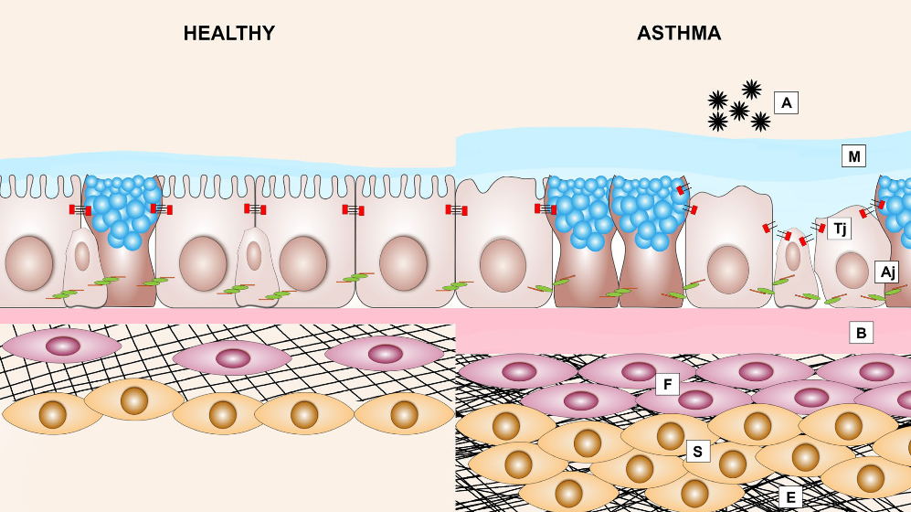
Epithelial barrier dysfunction – the basis of epithelium-mediated environmental hyperreactivity
Airway epithelial layer in asthma
is disrupted:
Detachment of ciliated cells
Presence of epithelial cell aggregates (creola bodies) in sputum
Reduced expression of cell-cell adhesion molecule E-cadherin
Heijink IH, et al. Allergy 2020;75:1902–1917
Image shows structural changes in the airways of patients with allergic asthma: epithelial barrier dysfunction and airway remodelling. Asthmatic airway epithelium exposed to allergens (A) results in the disruption of adherens junctions (Aj) and tight junctions (Tj), which is accompanied by loss of ciliated cells, mucus hypersecretion (M), thickening of the basal membrane (B), subepithelial fibrosis (F), increased smooth muscle
mass (S) and excessive deposition of extracellular matrix (E)
Heijink IH, et al. Allergy 2020;75:1902–1917

Slide 9
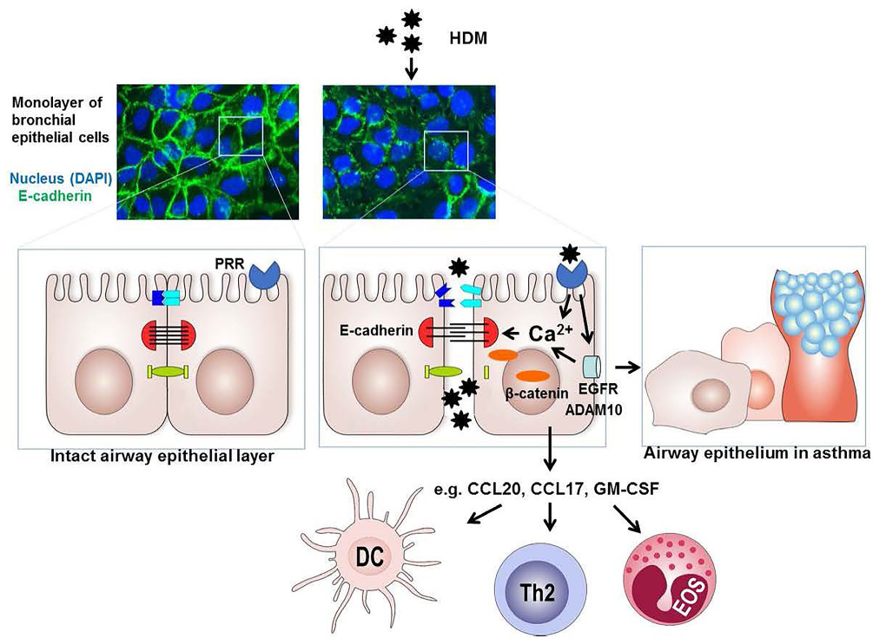
Epithelial barrier dysfunction – the basis of epithelium-mediated environmental hyperreactivity
Impaired barrier function
allows increased permeability to allergens
Epithelial denudation
with specific loss of epithelial cells
Impaired epithelial repair following injury
Spontaneous goblet
cell metaplasia
Heijink IH, et al. Allergy 2020;75:1902–1917
ADAM10, a disintegrin and metalloproteinase domain-containing protein 10; CCL, chemokine ligand; DAPI, 4',6-diamidino-2-phenylindole; DC, dendritic cell; EGFR, epidermal growth factor receptor;
EOS, eosinophil; GM-CSF, granulocyte-macrophage colony-stimulating factor; HDM, house dust mites; PRR, pattern recognition receptor; Th, T helper
Heijink IH, et al. Allergy 2020;75:1902–1917

Slide 10


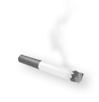
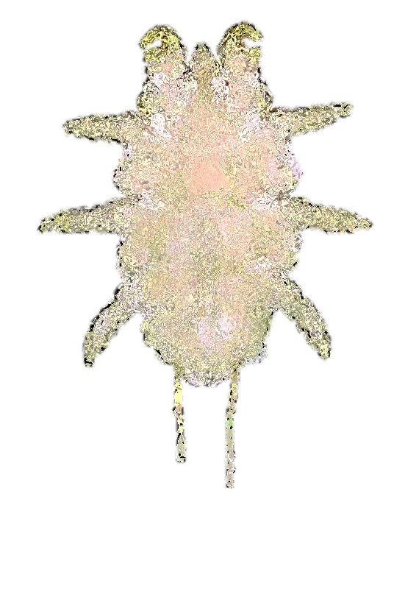
Environmental exposures trigger airway inflammation at the epithelium^{1–4}
Pathogens
Aeroallergens
Air pollutants
Respiratory viruses and bacteria^{1,2}
Dust mites, cockroaches, animal dander, moulds, pollen³
Smoke, dust, chemical pollution, particulate matter⁴
1. Wark PA, Gibson PG. Thorax 2006;61:909–915; 2. Iikura M, et al. PLoS One 2015;10:e0123584; 3. Baxi SN, Phipatanakul W. Adolesc Med State Art Rev 2010;21:57–71; 4. Lambrecht BN, et al. Immunity 2019;50:975–991

Slide 11

Asthma is driven by interactions between the environment, epithelium and immune system^{1–6}
Environmental exposures^{1,2}
Epithelium^{2–4}
Immune system^{5,6}
Key role in tissue homeostasis
Mediator between environment and immune system
Rapid production of epithelial cytokines in response to exposures
Allergic eosinophilic inflammation
Non-allergic eosinophilic inflammation
Non-T2 (non-eosinophilic) mechanisms
Structural cell changes
Viruses
Allergens
Pollutants/ smoke
Bacteria
Physical
injury
Other external stimuli (eg house dust mites)
T2, type 2
1. Pelaia G, et al. Nat Rev Drug Discov 2012;11:958–972; 2. Bartemes KR, Kita H. Clin Immunol 2012;143:222–235; 3. Watson B, Gauvreau GM. Expert Opin Ther Targets 2014;18:771–785; 4. Loxham M, et al. Clin Exp Allergy 2014;44:1299–1313; 5. Brusselle G, Bracke K. Ann Am Thorac Soc 2014;11(Suppl. 5):S322–S328; 6. Gauvreau GM, et al. Expert Opin Ther Targets 2020;24:777–792

Slide 12
Revisiting asthma pathology – environment and epithelial barrier dysfunction beyond atopy
Airflow limitation¹
In non-atopic individuals²
Epithelial barrier dysfunction²
Allergens²
Bronchial hyperreactivity¹
Inflammation¹
Defective AJCs
EMT
IFN deficiency
In atopic individuals²
Unbalanced innate immune response²
Th2 inflammation²
Impaired repair processes²
Image adapted from Caminati M, et al. World Allergy Organ J 2018;11:13 (http://creativecommons.org/licenses/by/4.0/)
AJC, apical junctional complex; EMT, epithelial mesenchymal transition; IFN, interferon; Th2, T helper type 2
1. Akdis CA, et al. Allergy 2020;75:1582–1605; 2. Caminati M, et al. World Allergy Organ J 2018;11:13

Slide 13
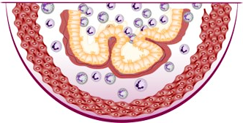

Airway inflammation and hyperresponsiveness are two key hallmarks of asthma^{1–3}
Asthma
Airway inflammation
Airway hyperresponsiveness
Involves numerous cell types, mediators and downstream immune pathways,^{1,4,5} and results in increased asthma symptoms^{1,4}
Multiple inflammatory endotypes have been characterised⁵
An intricate interplay of airway inflammation, airway remodelling⁶ and airway smooth muscle hypercontractility⁷
A key part of the diagnosis and management of asthma and in its classification of severity⁸
  Severity of airway hyperresponsiveness has been associated with increased asthma severity as measured by symptoms, risk of exacerbation and level of treatment required to control symptoms⁸
Improved asthma control and reduced morbidity have been observed with biologic treatments⁹
By specifically targeting inflammatory pathways, biologic therapies may offer new opportunities for
disease modification^{9,10} and could pave the way to considering asthma remission as a treatment goal^{9,11}
1. Busse WW. Allergol Int 2019;68:158–166; 2. Global Initiative for Asthma (GINA). Global strategy for asthma management and prevention. 2022. Available from: https://ginasthma.org/wp-content/uploads/2022/05/GINA-Main-Report-2022-FINAL-22-05-03-WMS.pdf (Accessed 25 May 2022); 3. West EE, et al. Drug Discov Today Dis Mech 2012;9:3–4; 4. Barnes PJ. Eur Respir Mon 2003;23:84–113; 5. Gauvreau GM, et al. Expert Opin Ther Targets 2020;24:777–792; 6. Comberiati P, et al. Immunol Allergy Clin North Am 2018;38:545–571; 7. Berair R, et al. J Allergy Cairo 2013;2013:185971; 8. Chapman DG, et al. Clin Exp Allergy 2015;45:706–719; 9. Menzies-Gow A, et al. J Allergy Clin Immunol Pract 2021;9:1090–1098; 10. Pavord I, et al. Eur Respir Rev 2019;28:190054; 11. Menzies-Gow A, et al. J Allergy Clin Immunol 2020;145:757–765
Notes:
Busse: pp 159, col 1, para 2, lines 2-11, 14-17
Barnes: pp84, para 1, lines 11-18; figure 1
Gauvreau: pp 777, col1, para 2, lines 1-5; pp777, col 2, para 2, lines 1-5.
Busse: abstract, lines 1-2
GINA: pp20, para 1 (definition of asthma), line 1; pp20, para 4, lines 4-5;
West: pp1, para 1, lines 2-5
Comberiati: pp548, para 2, lines 1-9
Berair: pp5, col 2, para 2 (all), para 3 (lines 1-3).
Chapman: pp706, col 1, para 1, lines 10-13; pp707, col 1, para 2, lines 1-3
Menzies-Gow: abstract, lines 1-6
Menzies-Gow: pp1090, col 2, para 1, lines 12-26; pp1097, col 2, para 4, lines 1-7
Pavord: pp8, para 4 (all)
Menzies-Gow 2020: pp758, col 1, para 1, lines 4-13; pp762, col 2, para 2, lines 1-3, 10-13
Gauvreau: pp777, col 1, para 2, lines 1-5
Comberiati: pp545, para 1, lines 1-2
Chapman: pp706, col 1, para 1, lines 1-4
Chapman: pp707, col 1, para 2, lines 5-9

Slide 14
Summary
Environment-epithelium interplay is a major driver of asthma pathology in terms of the
short-term (exacerbations) and long-term (remodelling) burden¹
Epithelial barrier dysfunction underlies asthma pathology regardless of atopic status or asthma severity^{1,2}
Environment cannot be easily changed, but the way the epithelium reacts against environmental triggers can be modulated by targeting airway inflammation and
hyperresponsiveness^{1,3}
In terms of pharmacological approach, different strategies are currently available, besides inhaled treatment, from immunotherapy to biologics depending on asthma phenotype and severity³
1. Caminati M, et al. World Allergy Organ J 2018;11:13; 2. Heijink IH, et al. Allergy 2020;75:1902–1917; 3. Akdis CA, et al. Allergy 2020;75:1582–1605

Slide 15
Many thanks for your attention

